Slide 1
EEB R Bootcamp Intro to class and basic stats and plotting
Noa Pinter-Wollman

Slide 2
Welcome!
Goals: Introduce graduate students to the R environment and provide a foundation for skills in scientific programming.
Course webpage with materials: http://michaelalfaro.github.io/eeb201/

Slide 3
Who R we?
Graduate students
Marvin Browne
Lauren Smith
Mark Juhn
Shawn Schwartz
Riley Mummah
Ana Gomez
Liz Karan
Christiane Jacquemetton
Maddi Cowen
Kenji Hayashi
Instructors
Noa Pinter-Wollman
Kirk Lohmueller
Mike Alfaro
Jamie Lloyd-Smith

Slide 4
Learning objectives
By the end of the course students will:
Be comfortable executing basic commands in the R environment.
Be able to load packages in R and make use of their added functionality.
Be able to read in data files, manipulate data, and perform simple analyses in R.
Be capable of plotting curves, scatter-plots, histograms, and other graphic outputs in R.
Be able to write their own computer programs to simulate population models in discrete or continuous time.

Slide 5
What is R?
“R is a language and environment for statistical computing and graphics”
A free, open-source, community-built software package.
Powerful, flexible computational tool with a broad array of add-on ‘packages’ that perform advanced analyses.
A high-level programming language for scientific computing.
A powerful platform for statistics.
A major research tool in ecology and other fields.

Slide 6
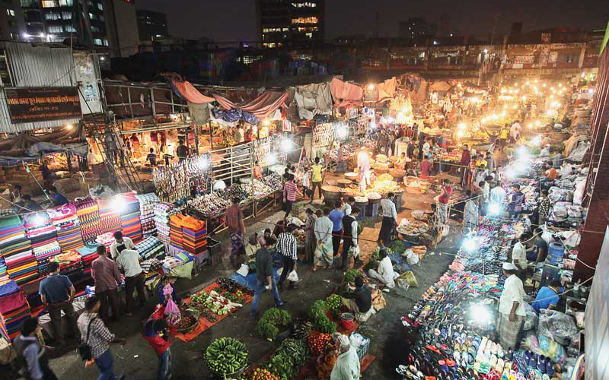

What is R not?
A commercial package
A drop-down menu environment
Excel
JMP, SPSS, SAS, etc.
Matlab

Slide 7

Why R?
Free
Widely used in ecology and evolution
Helpful, active, and large user community
Lots of resources (formal packages and informal community)
Versatile
Flexible
Data manipulation capabilities
Reproducible
Scalable
Transferable programming skills

Slide 8
R Bootcamp schedule
Wednesday September 18th
9-10:30 intro to the bootcamp and Basic stats and plotting – Pinter-Wollman
10:30-12 Advanced plotting - Lohmueller
12-1:30 Lunch
1:30-5PM Work on assignments
Thursday September 19th
9-10:30 Flow control, scripts, functions –Alfaro
10:30-12 Working with data and population dyanmics - Lloyd Smith
12:30-1:30 Lunch
1:30-5PM Work on assignments

Slide 9
What will you be learning in the next two days?
Command line, scripts, and functions
Getting help in R
Packages/libraries
Reading data
Variables
Subsetting and finding specific data
Control flow (for, if, while…)
Functions
Plotting
Basic modelling

Slide 10



R resources
https://cran.r-project.org/
R studio (https://www.rstudio.com/)
R for biologists (https://cran.r-project.org/doc/contrib/Martinez-RforBiologistv1.1.pdf)
Springer series ‘Use R!’ is available free through UCLA library
R for Data Science http://r4ds.had.co.nz/
Quick R: http://www.statmethods.net/
R reference card: ftp://cran.r-project.org/pub/R/doc/contrib/Short-refcard.pdf
R colors: http://research.stowers-institute.org/efg/R/Color/Chart/ColorChart.pdf
Other grad students
Stats consulting on campus
Google!

Slide 11
What is the plan for the next 1.5 hours?
Running statistical tests
Plotting

Slide 12
Basic statistics
T-tests
ANOVA
Correlation
Other linear models
More advances statistics – EEB202C

Slide 13
Some advice on script layout
Setup (e.g., clean workspace, load packages)
rm(list=ls()) # clean workspace
graphics.off() #close all figures
#load packages
library(‘igraph’)
2. Load data and prepare it for analysis (e.g., subset, assign data type…)
3. Perform analysis
4. Display results (plot, save output etc…)

Slide 14
Comparing means of groups
Sepal length
Sepal width
Petal length
Petal width

